Slide 1
Advances in Deep Audio and Audio-Visual Processing
ELEG5491: Introduction to Deep Learning
Hang Zhou

Slide 2
Table of Contents
Audio Representations
Spectrogram Based Methods
WaveNet and Its Varients
Audio-Visual Joint Learning

Slide 3
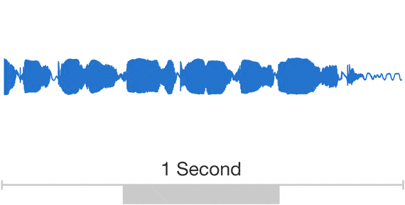
Audio Representations: Raw Audio Signals
Audio data usually stored with information about Sampling Rate (e.g. 16000 Hz, with 16000 points a second), and BitsPerSample (The scale that audio is saved, e.g. 2^16 for 16 bit)
Raw audio contains important structure at many time-scales with an extremely high sampling rate of over 16000 points a second.

Slide 4
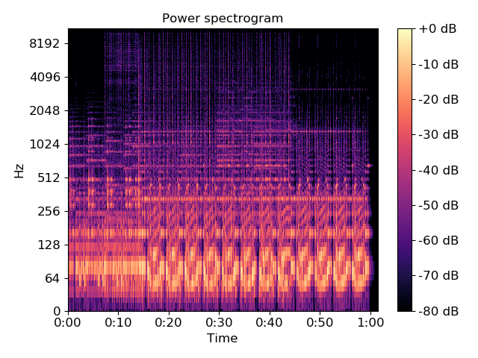
Audio Representations: Spectrogram
Visual representation of the spectrum of frequencies of a signal as it varies with time.
Short-time Fourier transform (STFT).
Tacotron: Towards End-to-End Speech Synthesis

Slide 5
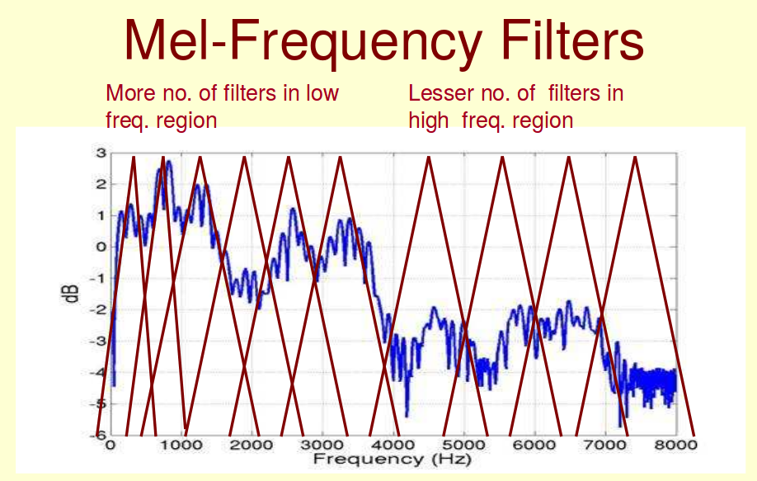
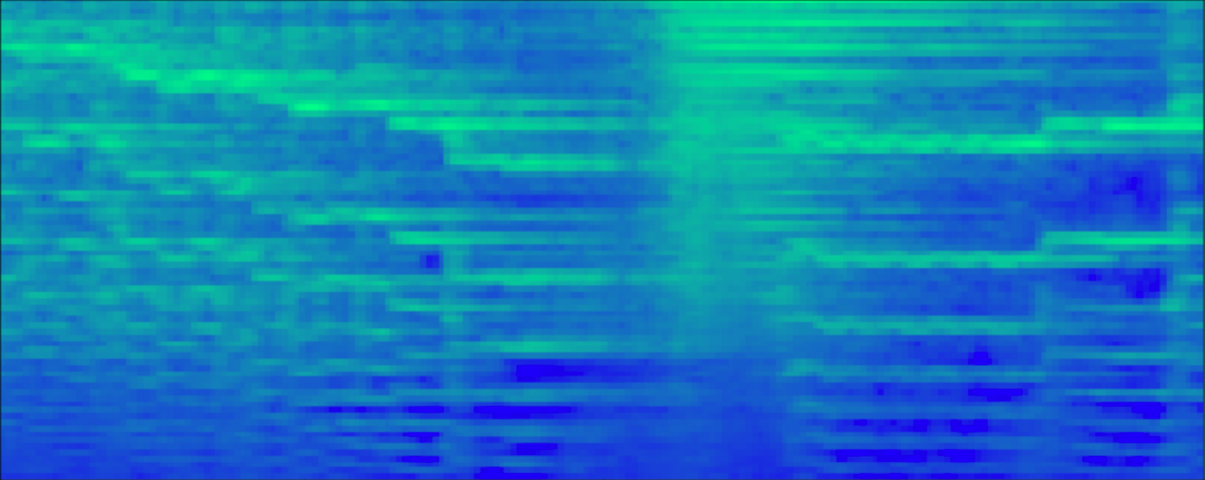
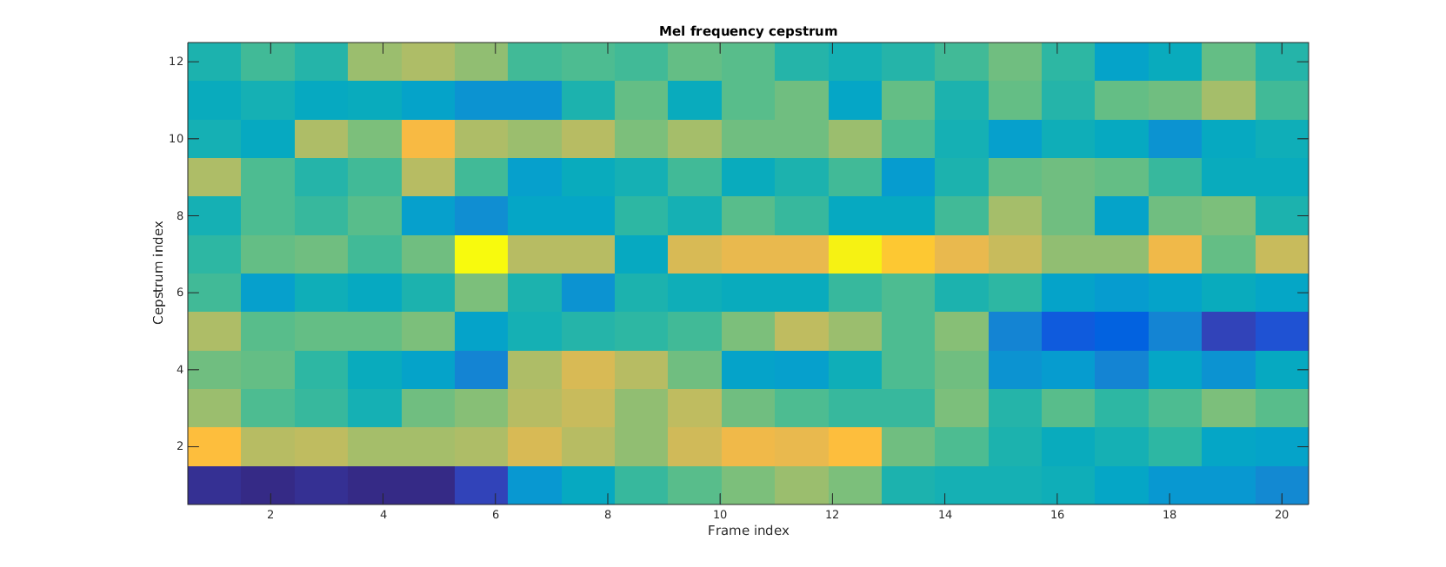
Audio Representations: Spectrogram
Mel-Frequency analysis of speech is based on human perception experiments.
Filters are non-uniformly spaced on the frequency axis.
Mel-Spectrogram.
Mel-Frequency Cepstral Coefficients (MFCC)
http://www.speech.cs.cmu.edu/15-492/slides/03_mfcc.pdf

Slide 6
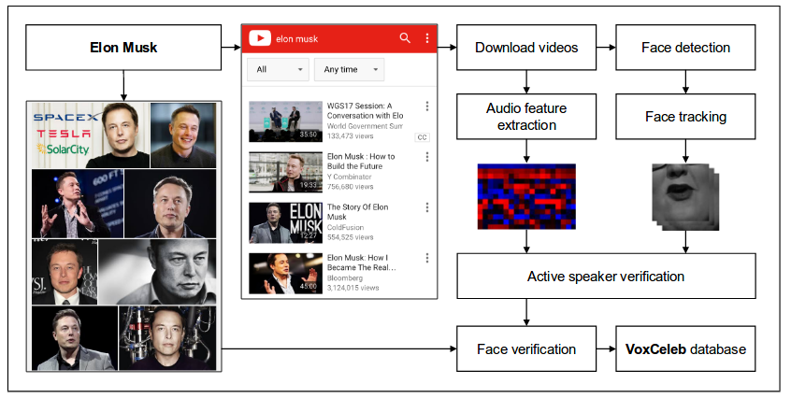
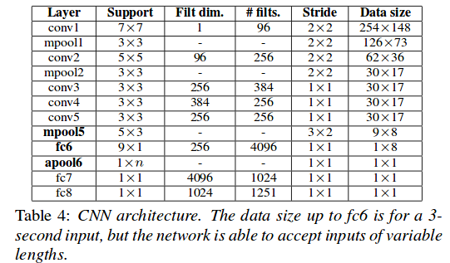
Spectrogram Based Speaker Verification
CNN for speaker verification. (Audio classification)
Input STFT of size 512 x 300 for 3 seconds of speech.
VoxCeleb: a large-scale speaker identification dataset. INTERSPEECH 2017.

Slide 7
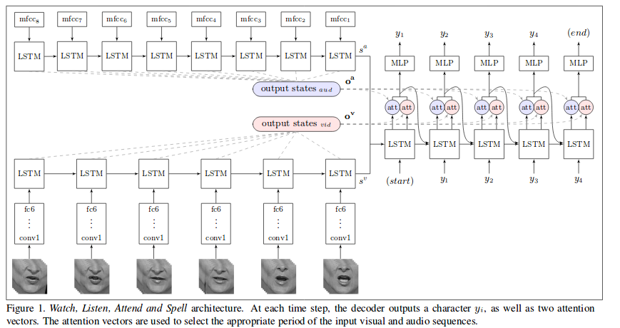
Spectrogram Based Recognition
Speech recognition using biLSTM with attention.
MFCC has been used for speech recognition for really long.
Lip reading sentences in the wild. CVPR 2017.

Slide 8
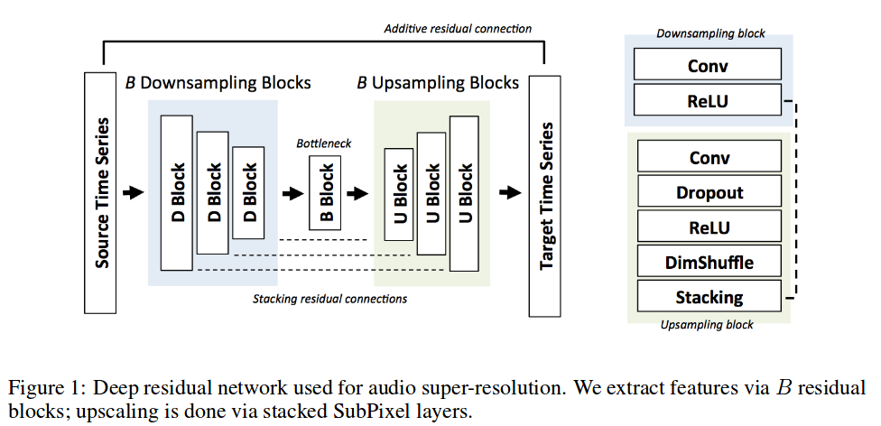
Spectrogram Based Super Resolution
Audio Super Resolution using Neural Networks. ICLR 2017 workshop

Slide 9
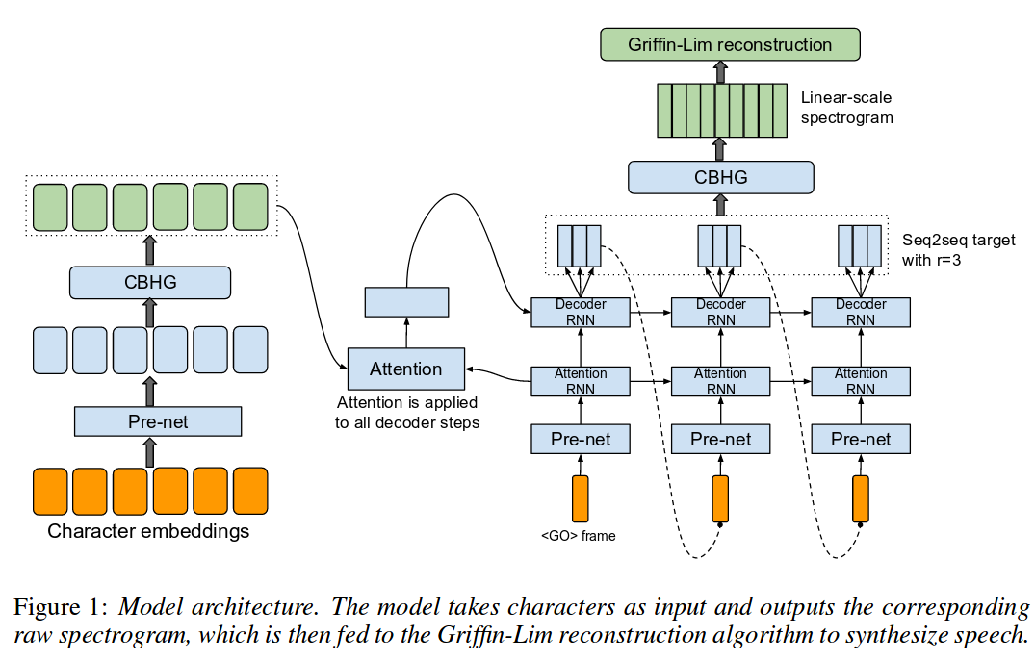
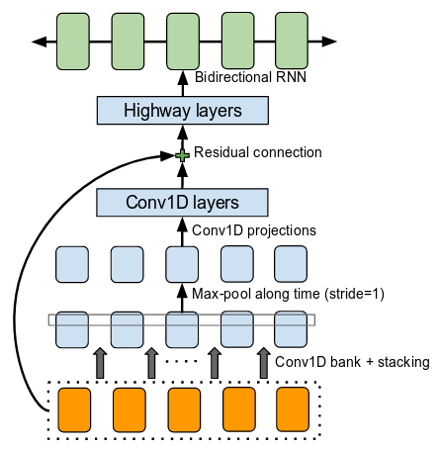
End-to-end Text-to-speech (TTS): Tacotron
End-to-end generative TTS model based on the sequence-to-sequence (seq2seq).
CBHG: convolution bank + highway networks + B-GRU
Tacotron: Towards End-to-End Speech Synthesis

Slide 10
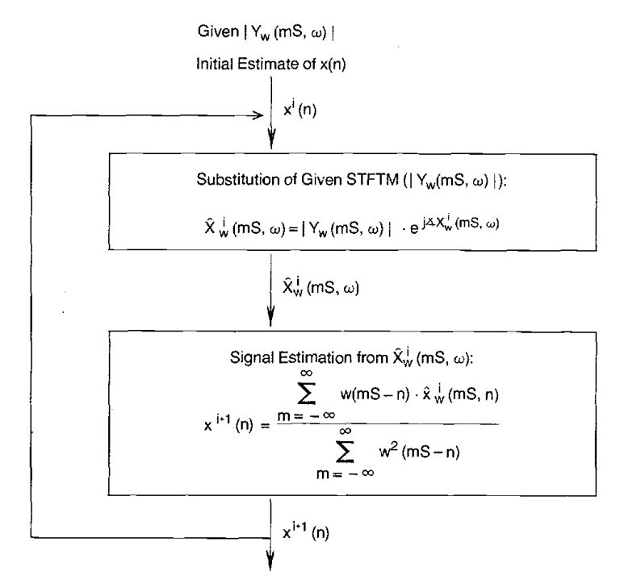
From Spectrogram to Audio: Griffin-Lim
Spectrograms have only the magnitude part without the phase part.
Griffin-Lim converges towards the estimated phase layer.
Signal estimation from modified short-time fourier transform. Transactions on Acoustics, Speech, and Signal Processing

Slide 11
WaveNet for Raw Audio Generation
Deep neural network for generating raw audio.
Fully probabilistic and autoregressive, predictive distribution for each audio sample conditioned on all previous ones.
Provide a generic and flexible framework for tackling many applications that rely on audio generation. (e.g. TTS, music, speech enhancement, voice conversion, source separation)
van den Oord et. al. WaveNet: A Generative Model for Raw Audio

Slide 12
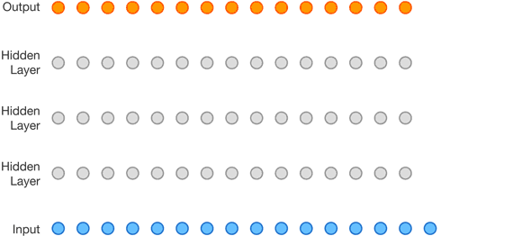
WaveNet Structure
Fully convolutional neural network.
No pooling layers in the network, output with same time dimensionality as the input.
Convolutional layers have various dilation factors.
Allow its receptive field to grow exponentially with depth.
van den Oord et. al. WaveNet: A Generative Model for Raw Audio

Slide 13
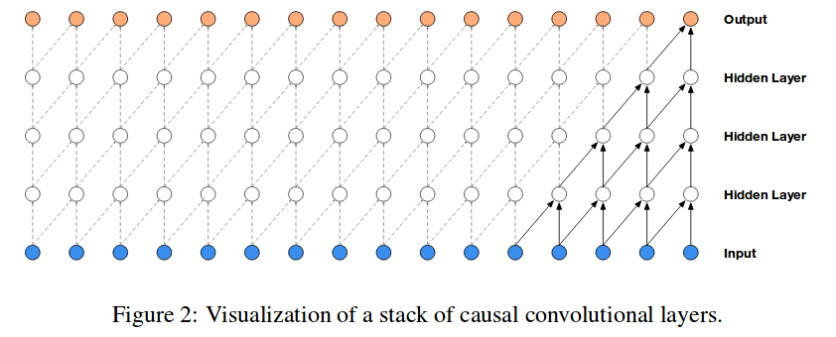
WaveNet Structure —— Casual Convolution
Casual convolution, prediction cannot be made depending on future timesteps.
No recurrent connections, typically faster to train than RNNs.
Require many layers, or large filters to increase the receptive field. (Below has only the receptice field of 5)

Slide 14
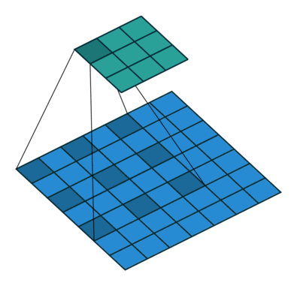
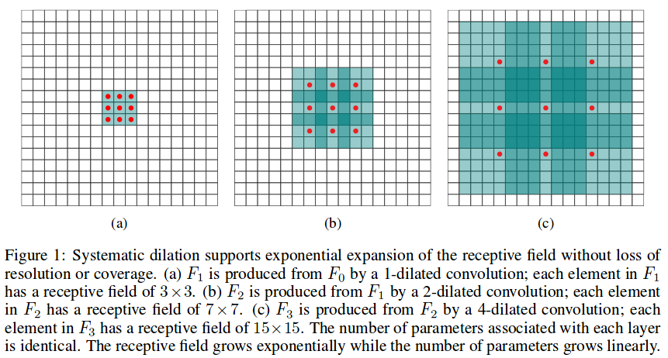
Dilated Convolution
Multi-Scale Context Aggregation by Dilated Convolutions. ICLR 2016

Slide 15
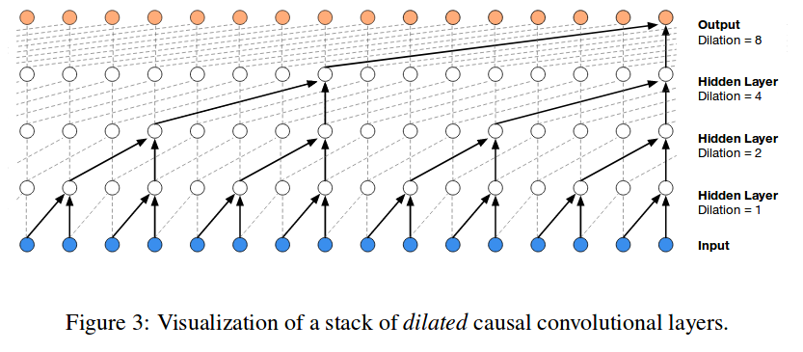
WaveNet Dilated Convolution
Filter is applied over an area larger than its length by skipping input values with a certain step.
Enable networks to have very large receptive fields with just a few layers.

Slide 16
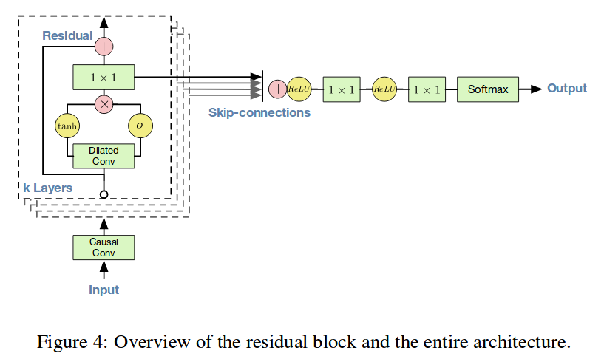
WaveNet Details
Residual and skip connections.
Training loss: 8-bit mu-law encoding and predict each output step with a softmax over the resulting 256 values.

Slide 17
Conditional WaveNet
Model the conditional distribution
Multi-speaker setting: conditioning on speaker information.
In TTS: Use text as an extra input.
Global conditioning (speaker) and local conditioning (text).

Slide 18
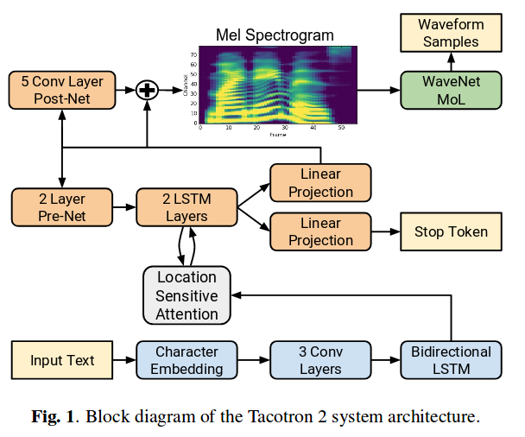
Tacotron2: TTS with Wavenet and Mel Spectrogram
Natural TTS Synthesis By Conditioning Wavenet On Mel Spectrogram Predictions. ICASSP 2018

Slide 19
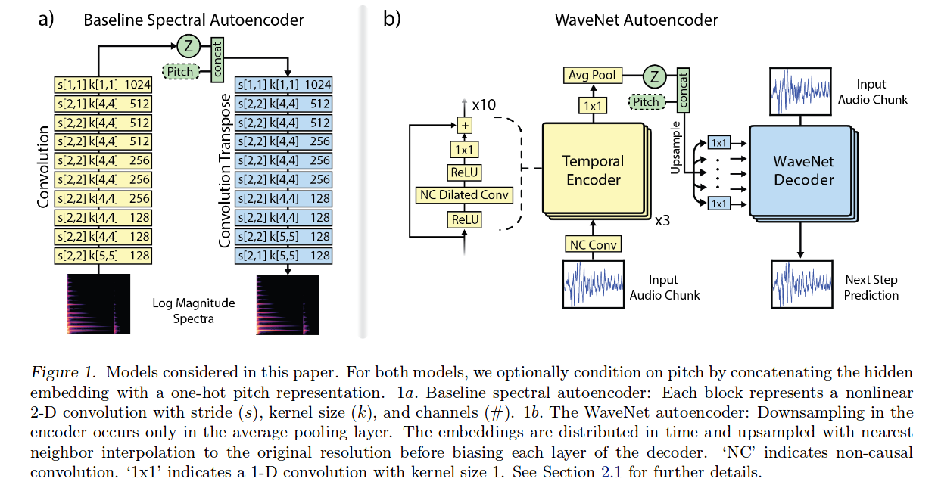
WaveNet Autoencoder
Learn a semantically meaningful hidden representation.
Generate new types of expressive and realistic instrument sounds.
Neural Audio Synthesis of Musical Notes with WaveNet Autoencoders. ICML 2017

Slide 20
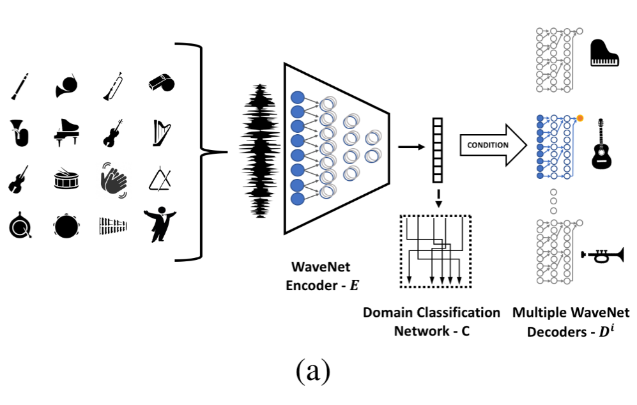
Autoencoder-based Music Translation
A domain confusion network that provides an adversarial signal to the encoder.
Distorting the input audio by random local pitch modulation.
Autoencoder-based Music Translation. ICLR 2019

Slide 21
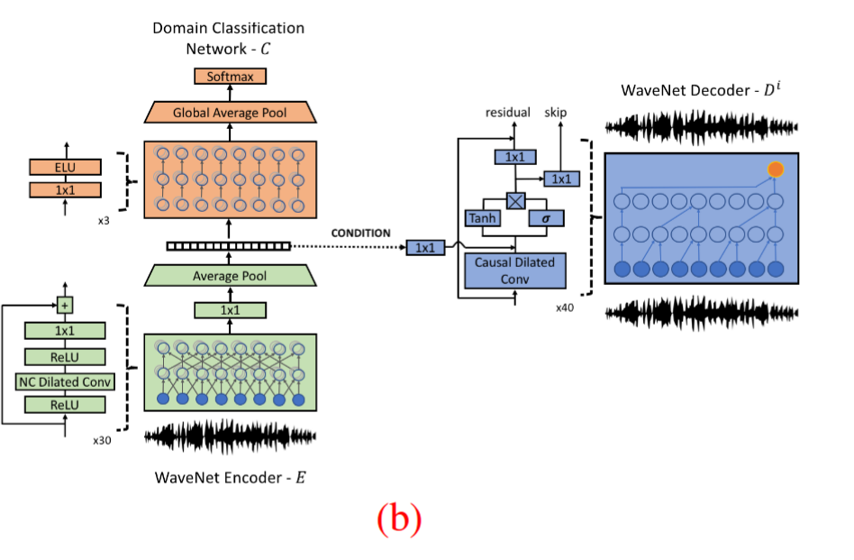
Autoencoder-based Music Translation
https://www.youtube.com/watch?v=vdxCqNWTpUs
Autoencoder-based Music Translation. ICLR 2019

Slide 22
Audio-Visual Joint Processing
Audio-visual synchronizing.
Audio-visual speech recognition.
Audio-based video generation.
Vision-based audio generation.
Audio-visual source separation.
And many more.

Slide 23
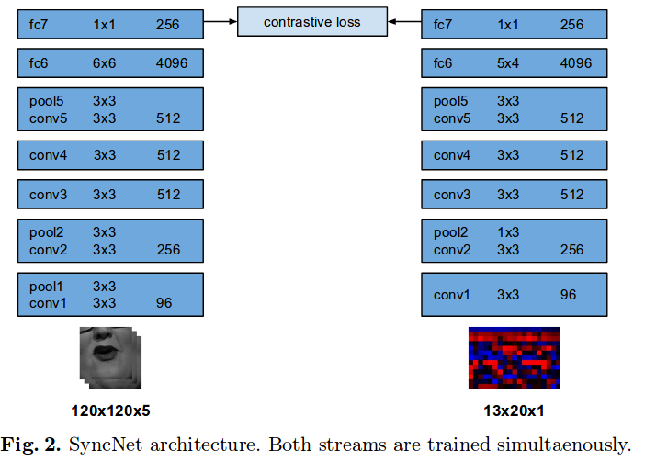
Audio-Visual Synchronizing
Out of time: automated lip sync in the wild. ACCV workshop 2016

Slide 24
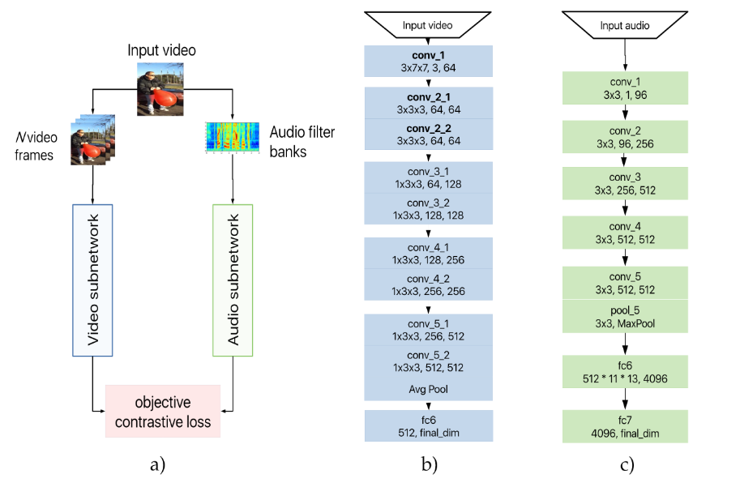
Audio-Visual Synchronizing
Cooperative Learning of Audio and Video Models from Self-Supervised Synchronization. NerIPS 2018

Slide 25
Audio-visual Speech Recognition.
Lip reading sentences in the wild. CVPR 2017.

Slide 26
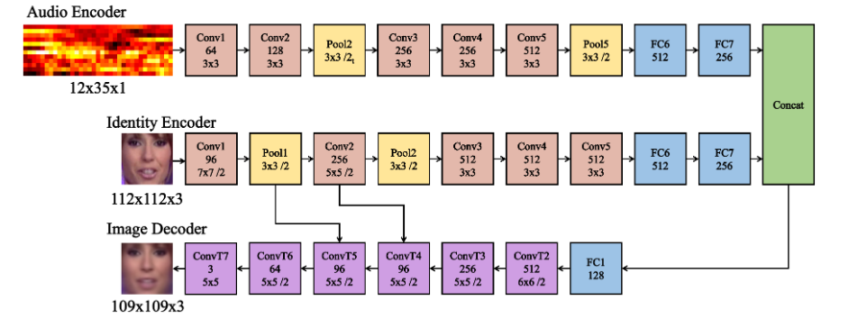
Audio-based Video Generation
You said that? BMCV 2017

Slide 27
Audio-based Video Generation
Talking face generation by adversarially disentangled audio-visual representation. AAAI 2019

Slide 28
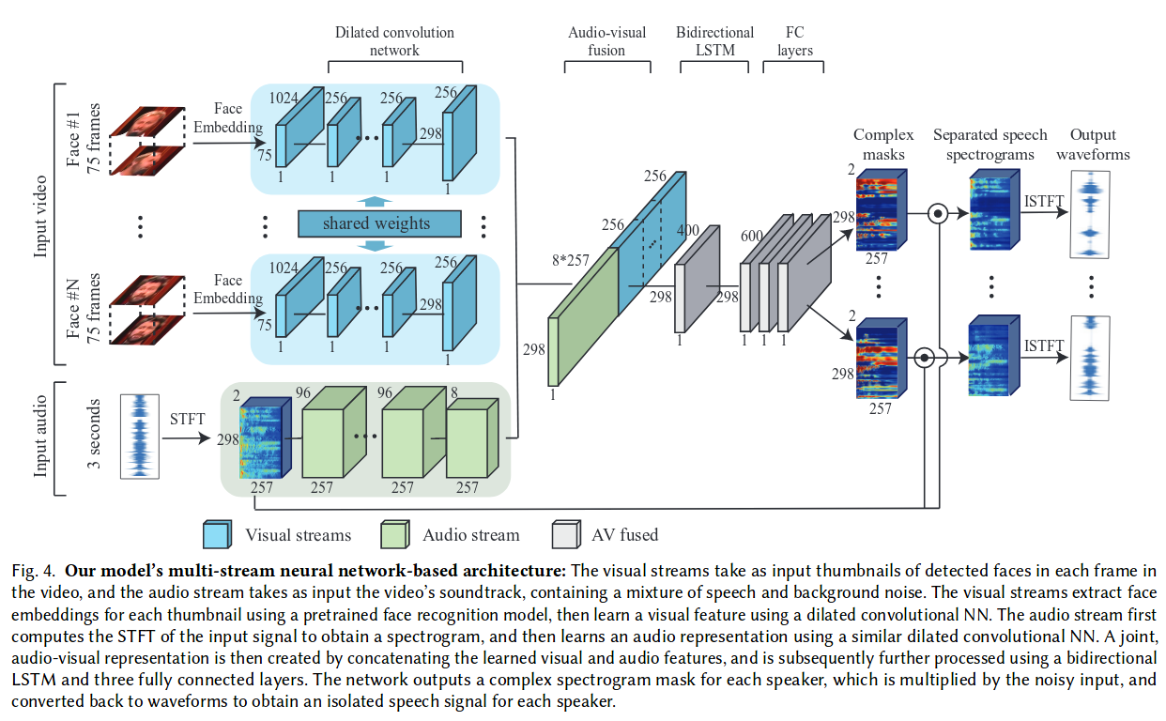
Audio-visual source separation
https://www.youtube.com/watch?v=rVQVAPiJWKU
Looking to Listen at the Cocktail Party: A Speaker-Independent Audio-Visual Model for Speech Separation. SIGGRPAH 2018

